Slide 1
Moraga School District Citizen Bond Oversight Committee
December 13, 2017
District Report
Presented by Bruce K. Burns, Superintendent
~ Project Photos
~ Steering Committee ~ Web Site ~ Consultant Selection
Notes:
Recent Activity
Next Steps
Accounting Update

Slide 2
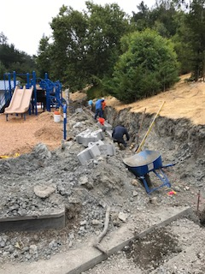
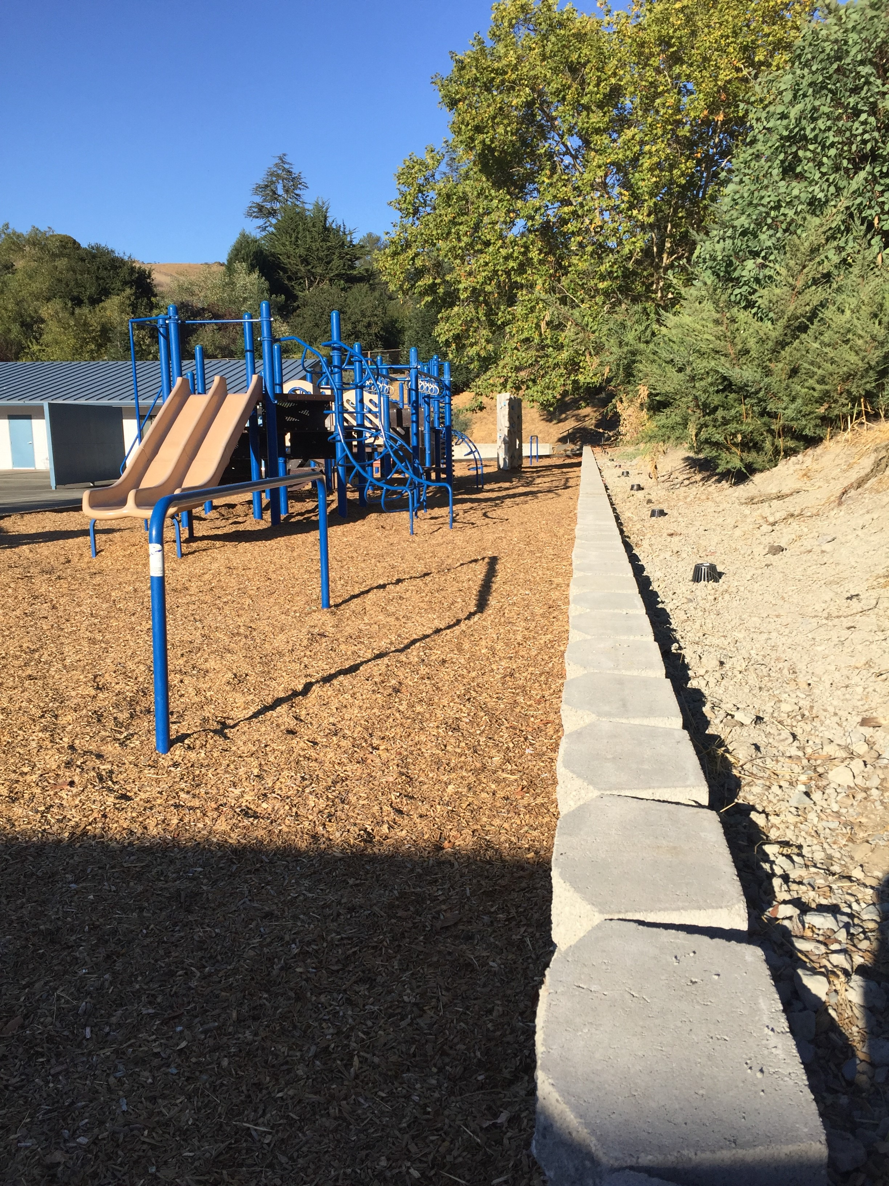
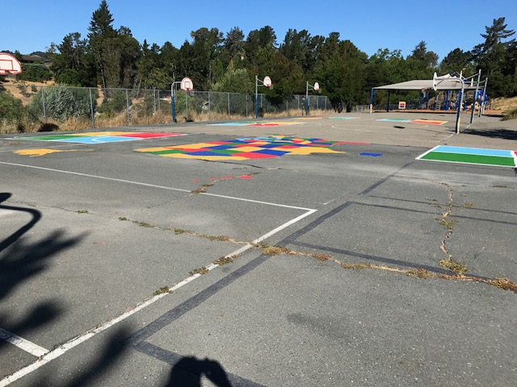
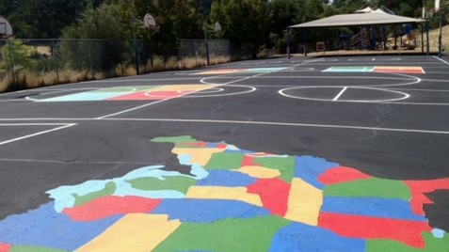
Recent Construction Activity
Camino Pablo School Retaining Wall, East Playground
Los Perales School Plaza de Amigo Playground

Slide 3
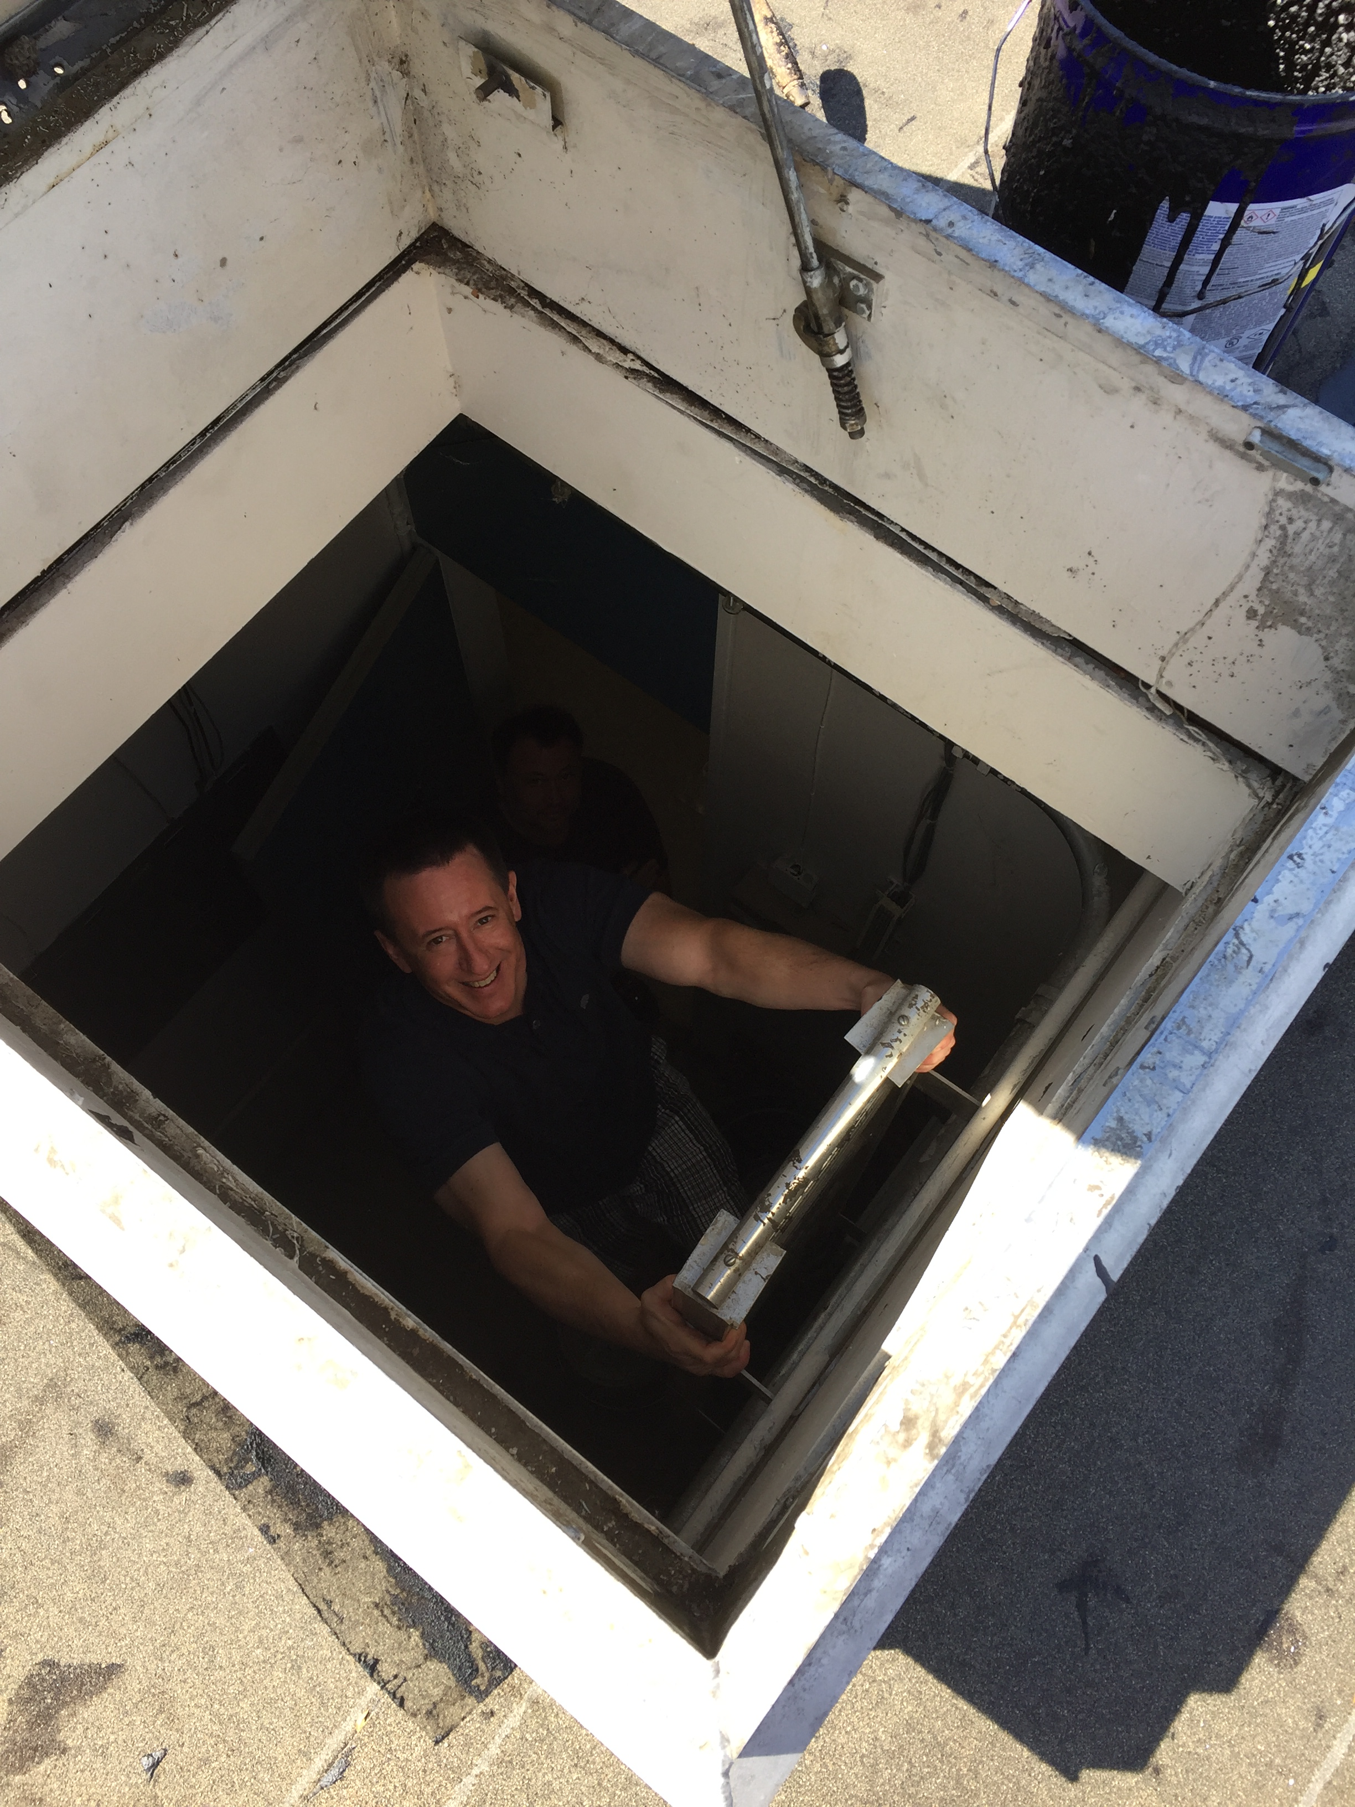
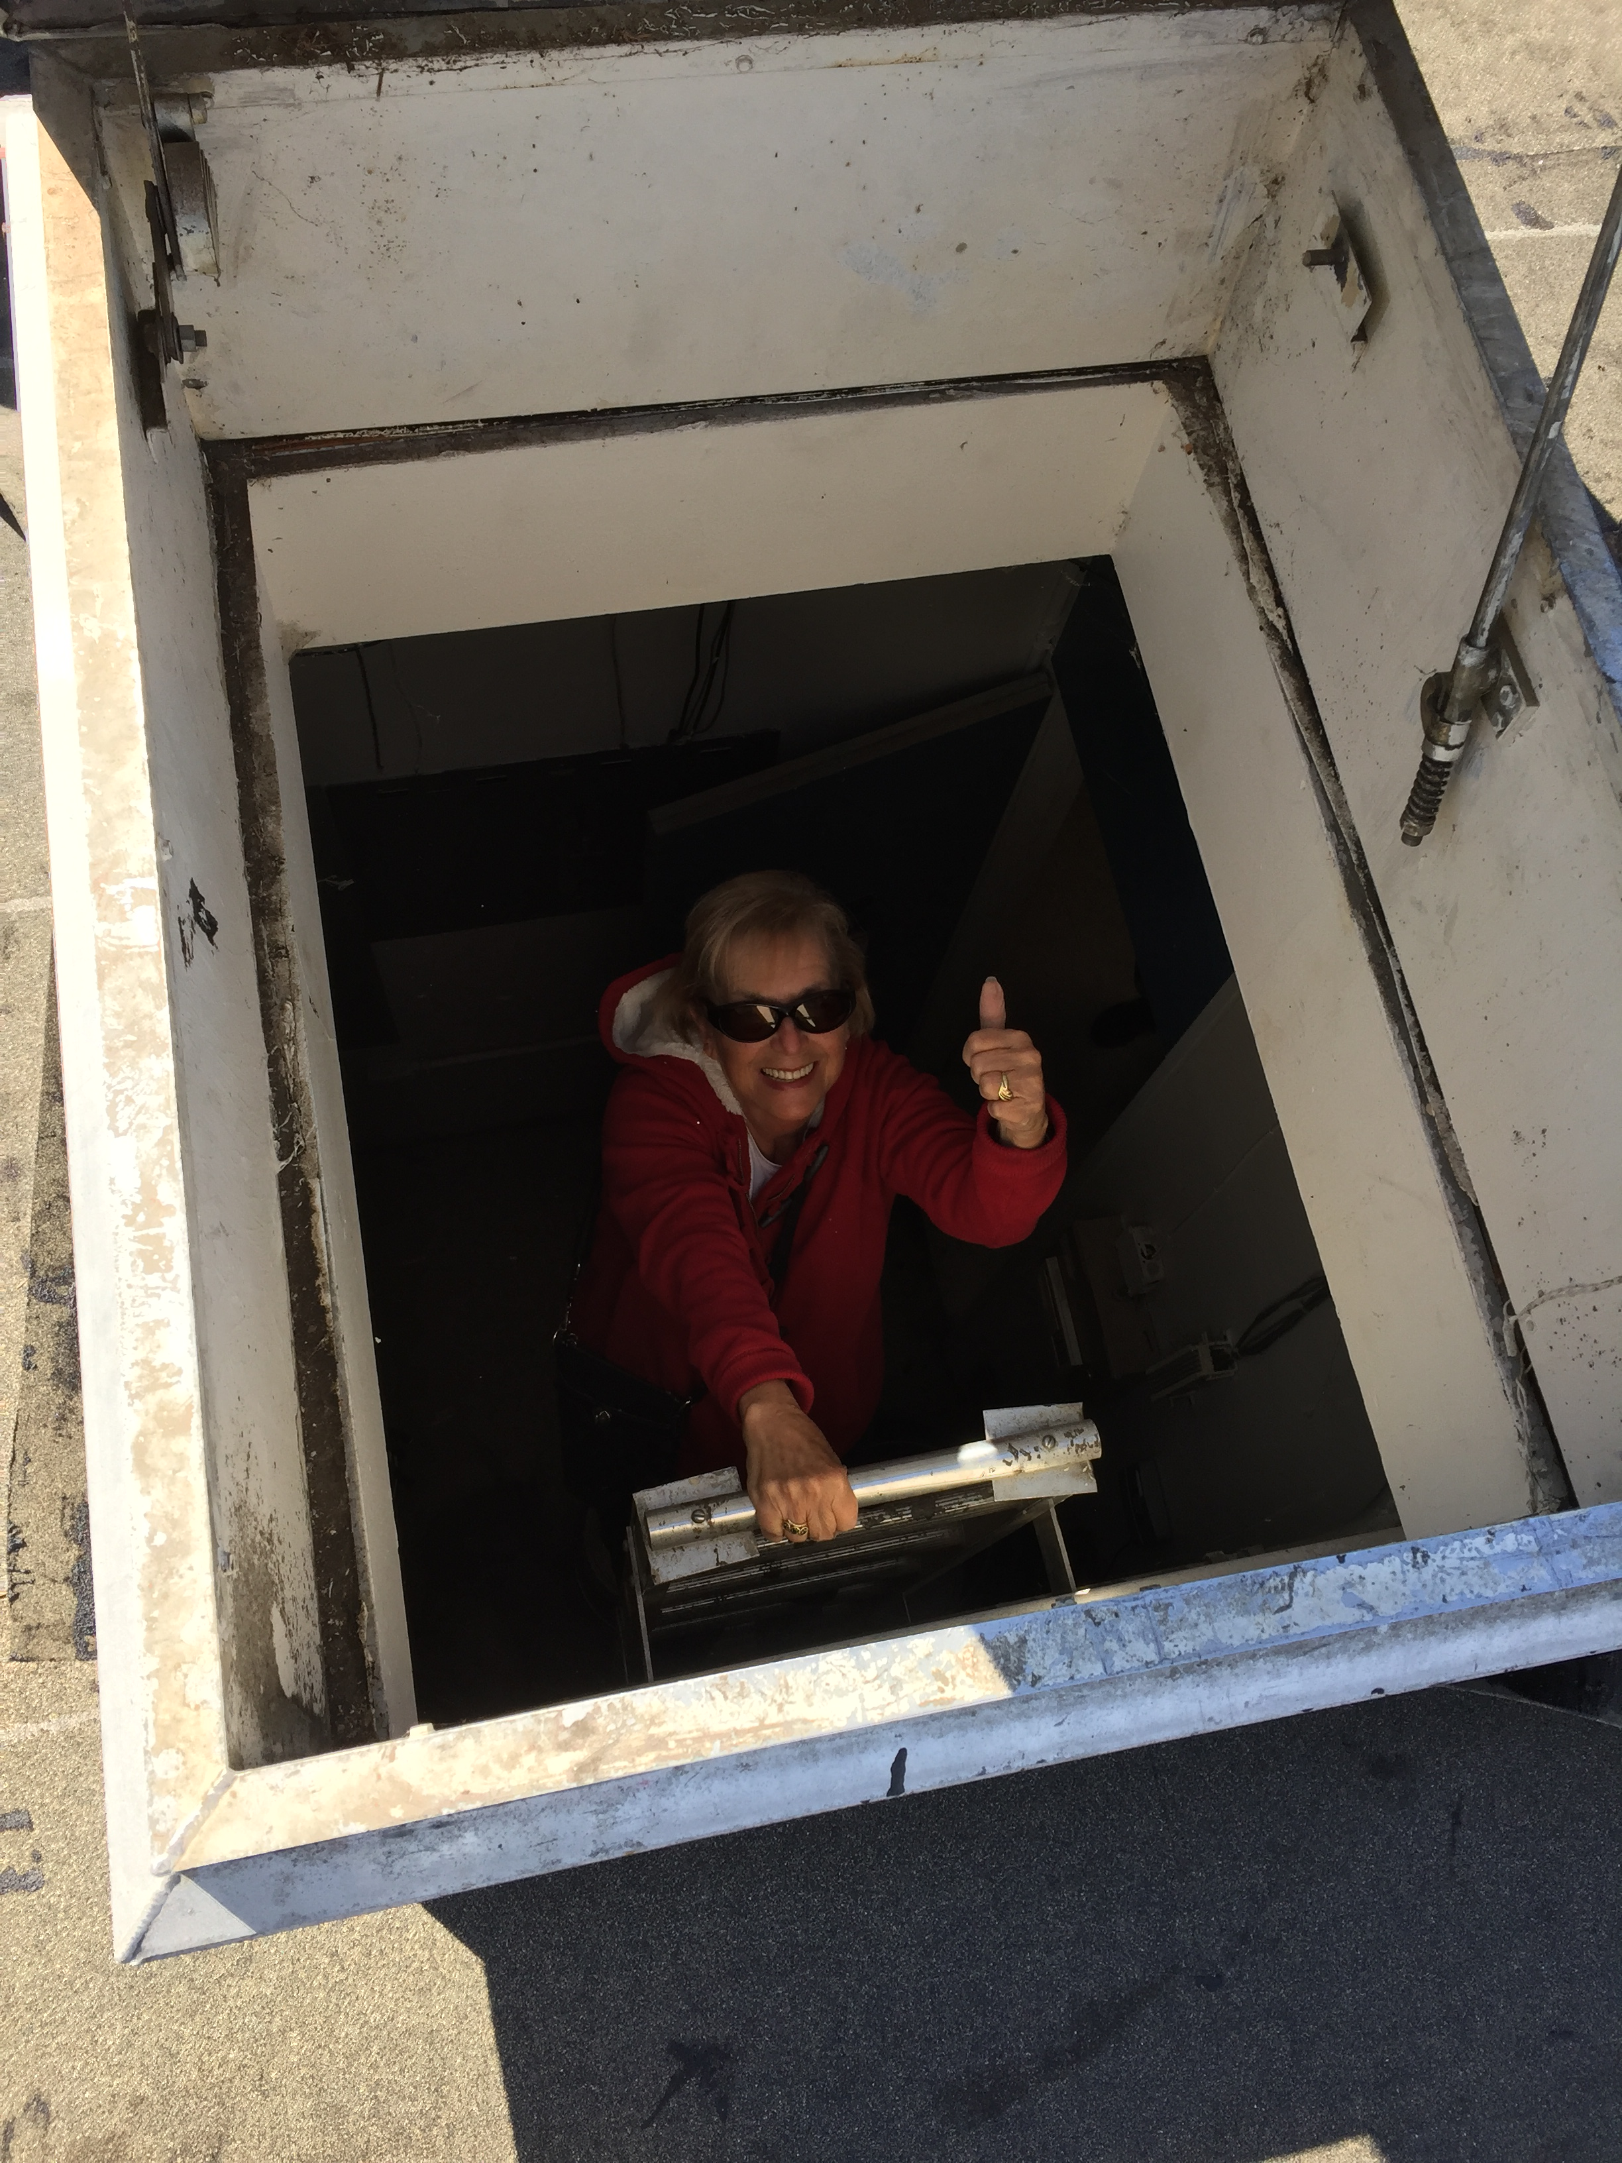
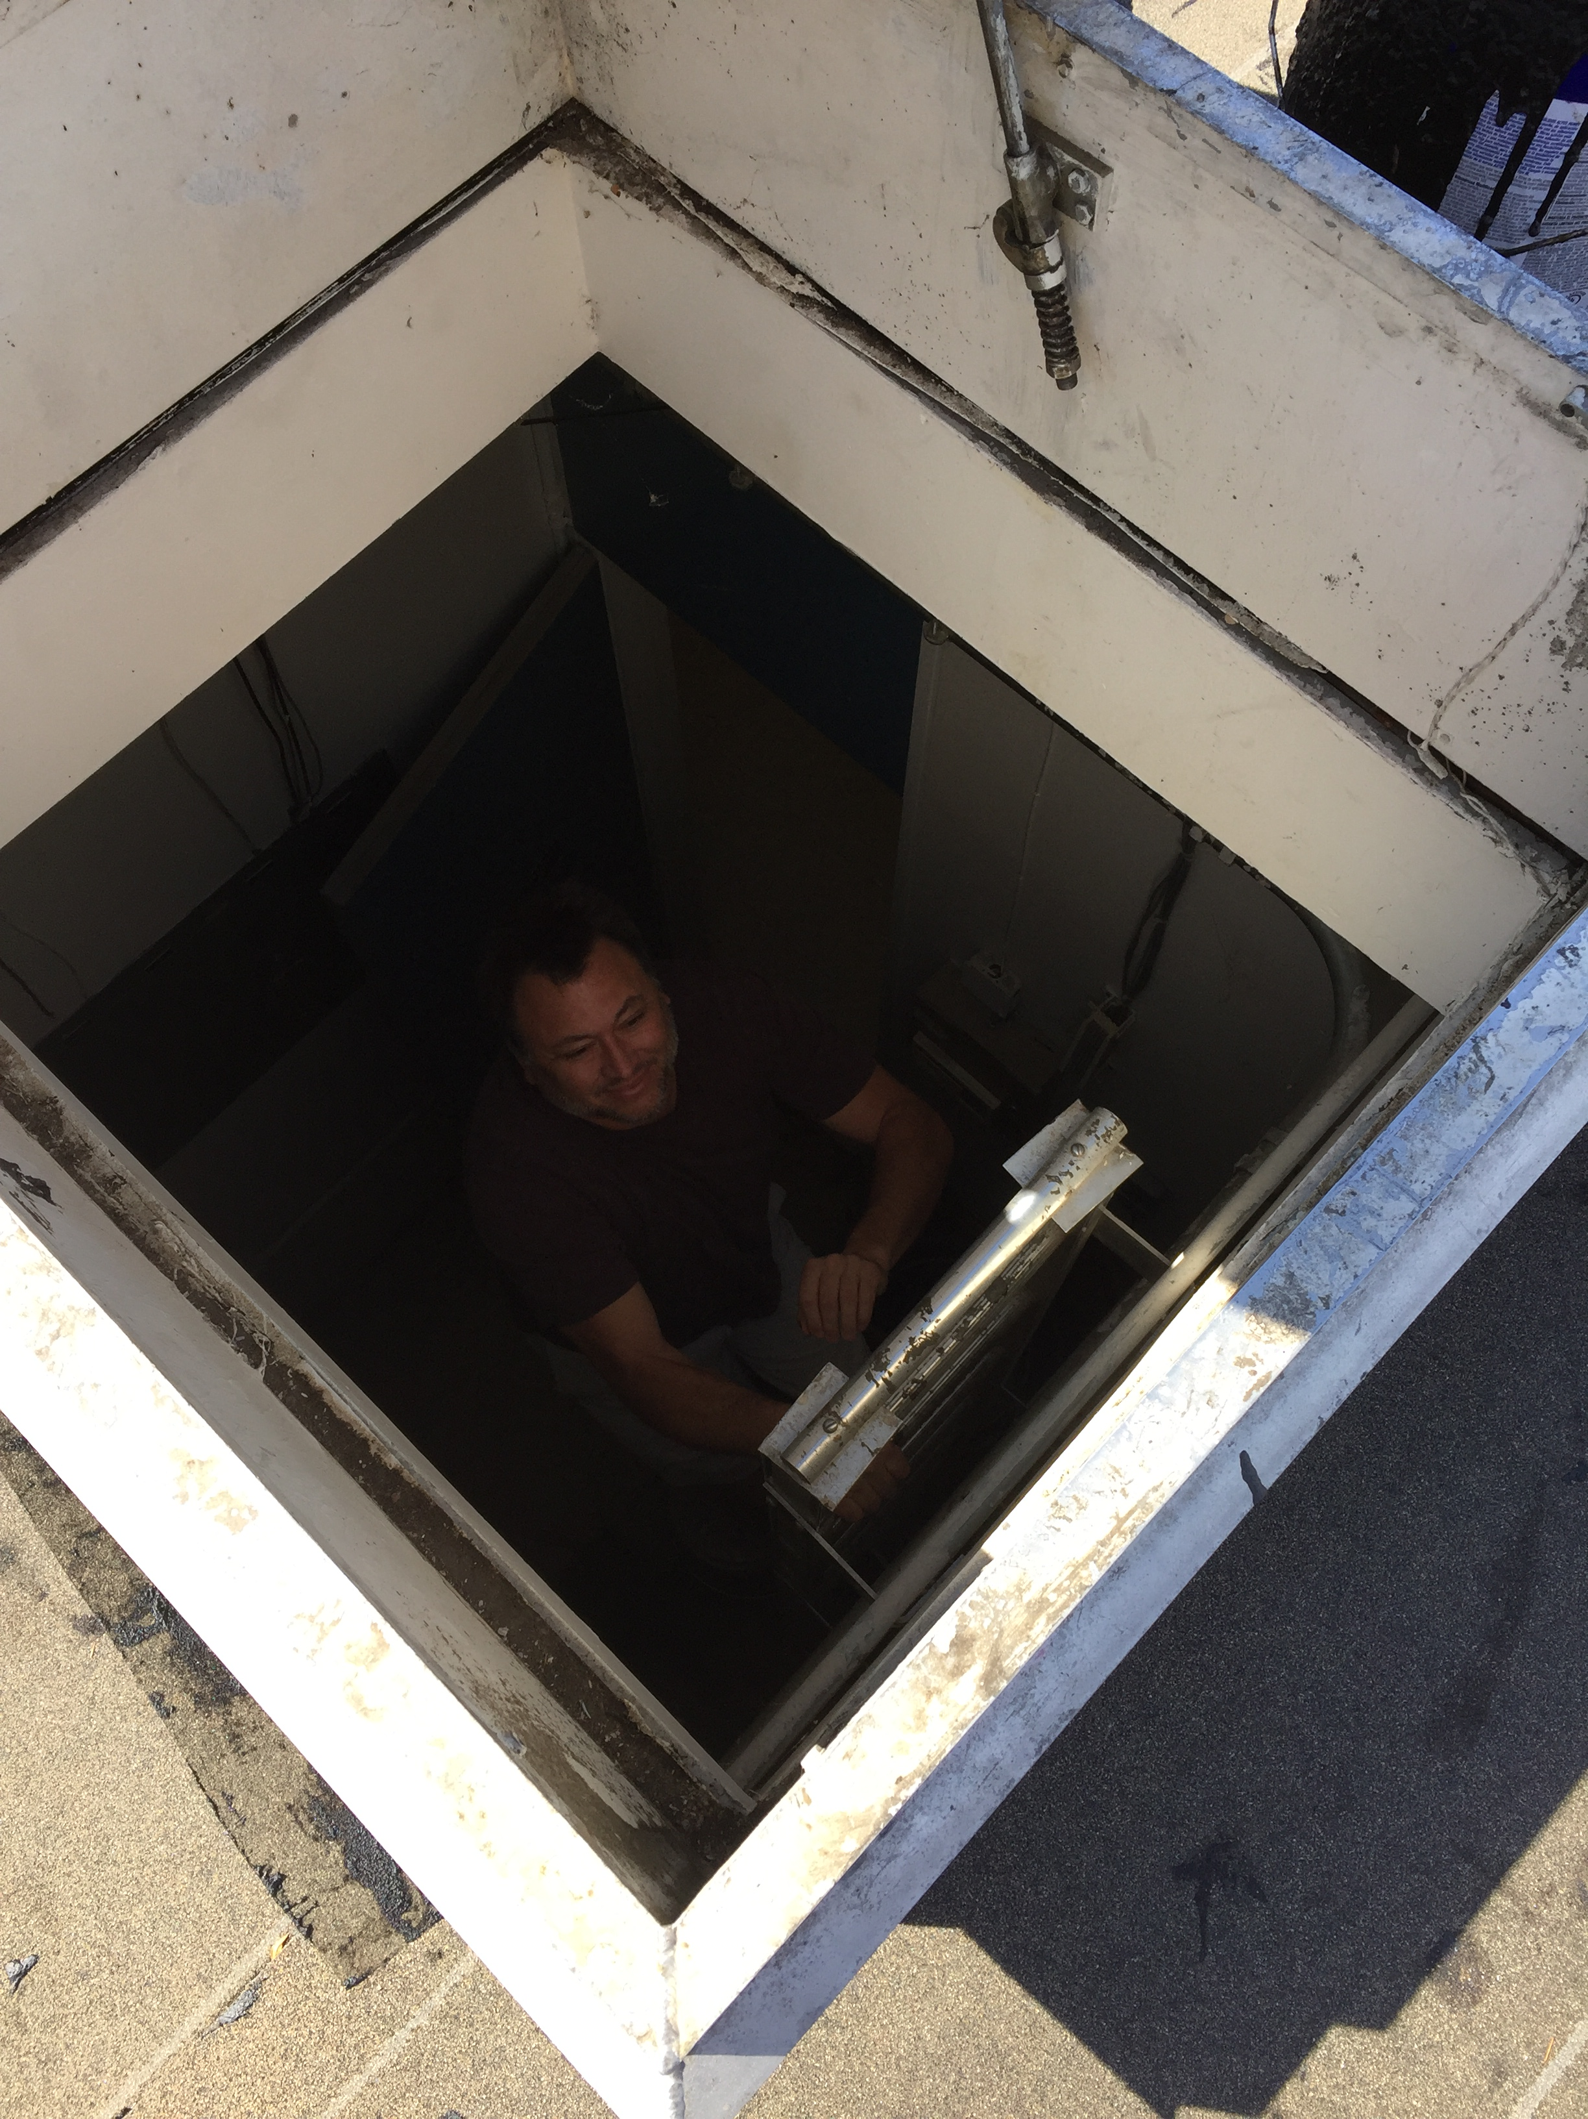
CBOC Inspection Team
Aaron, Lynette, Scott

Slide 4
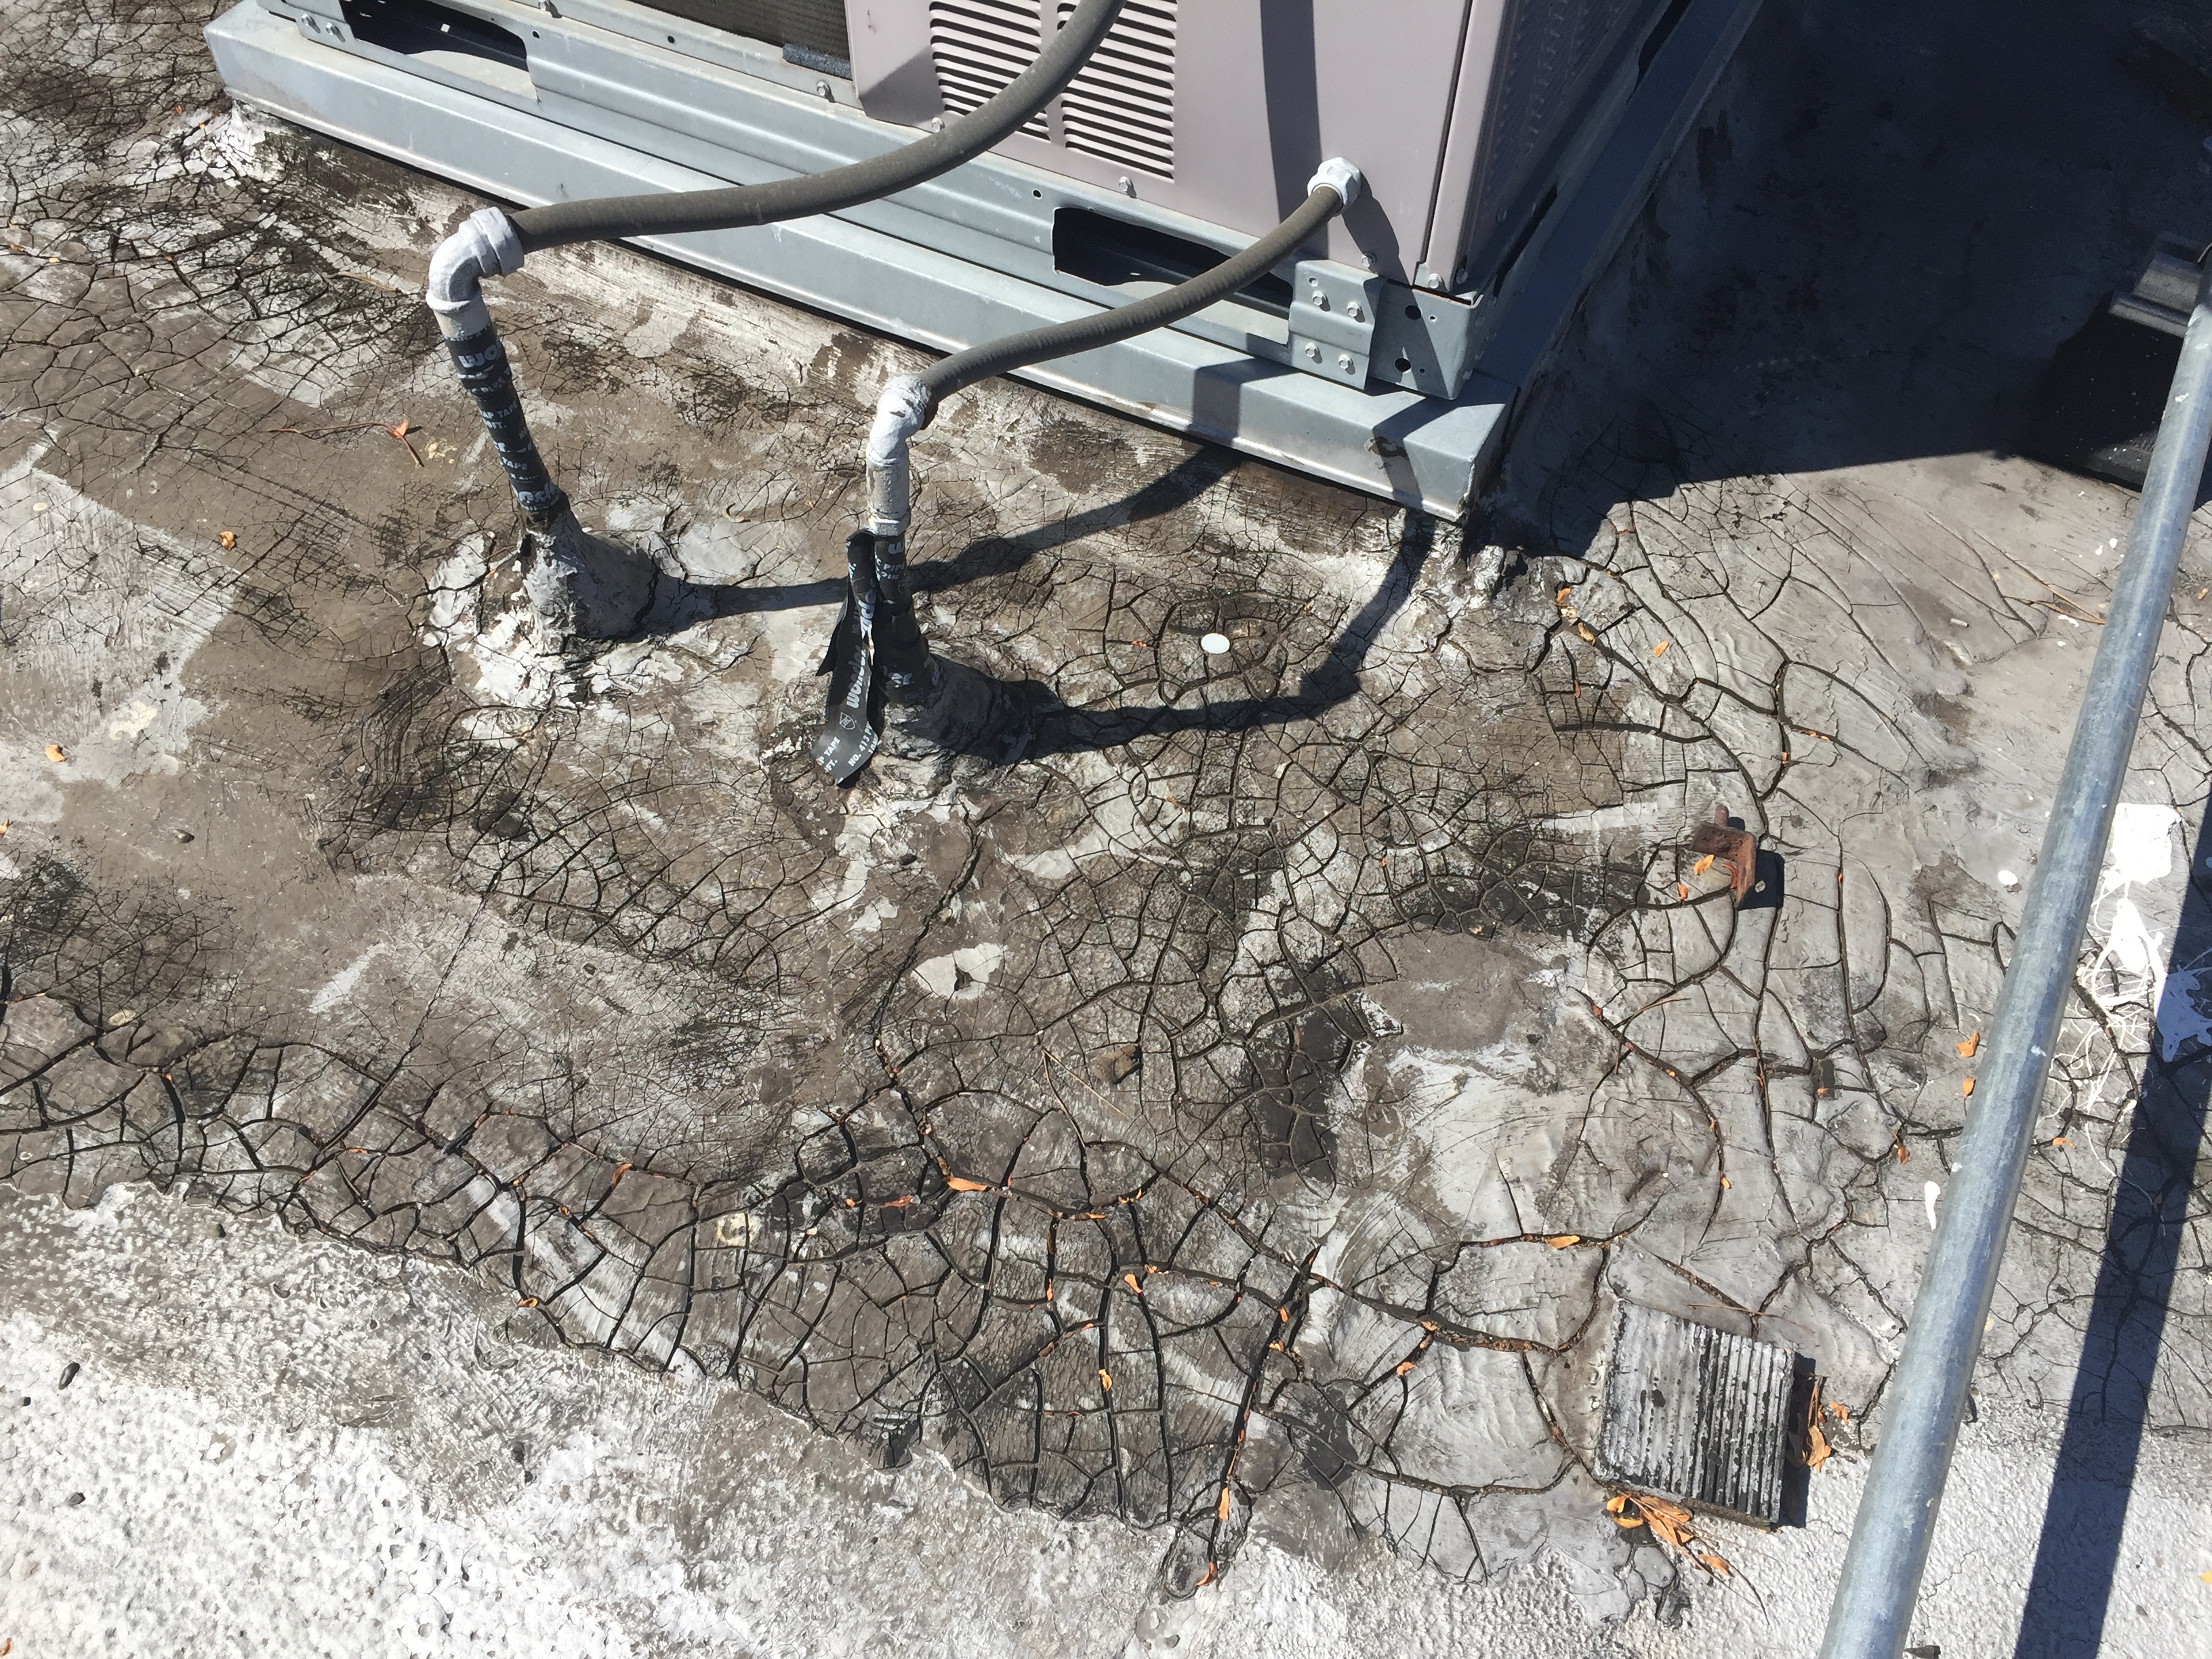
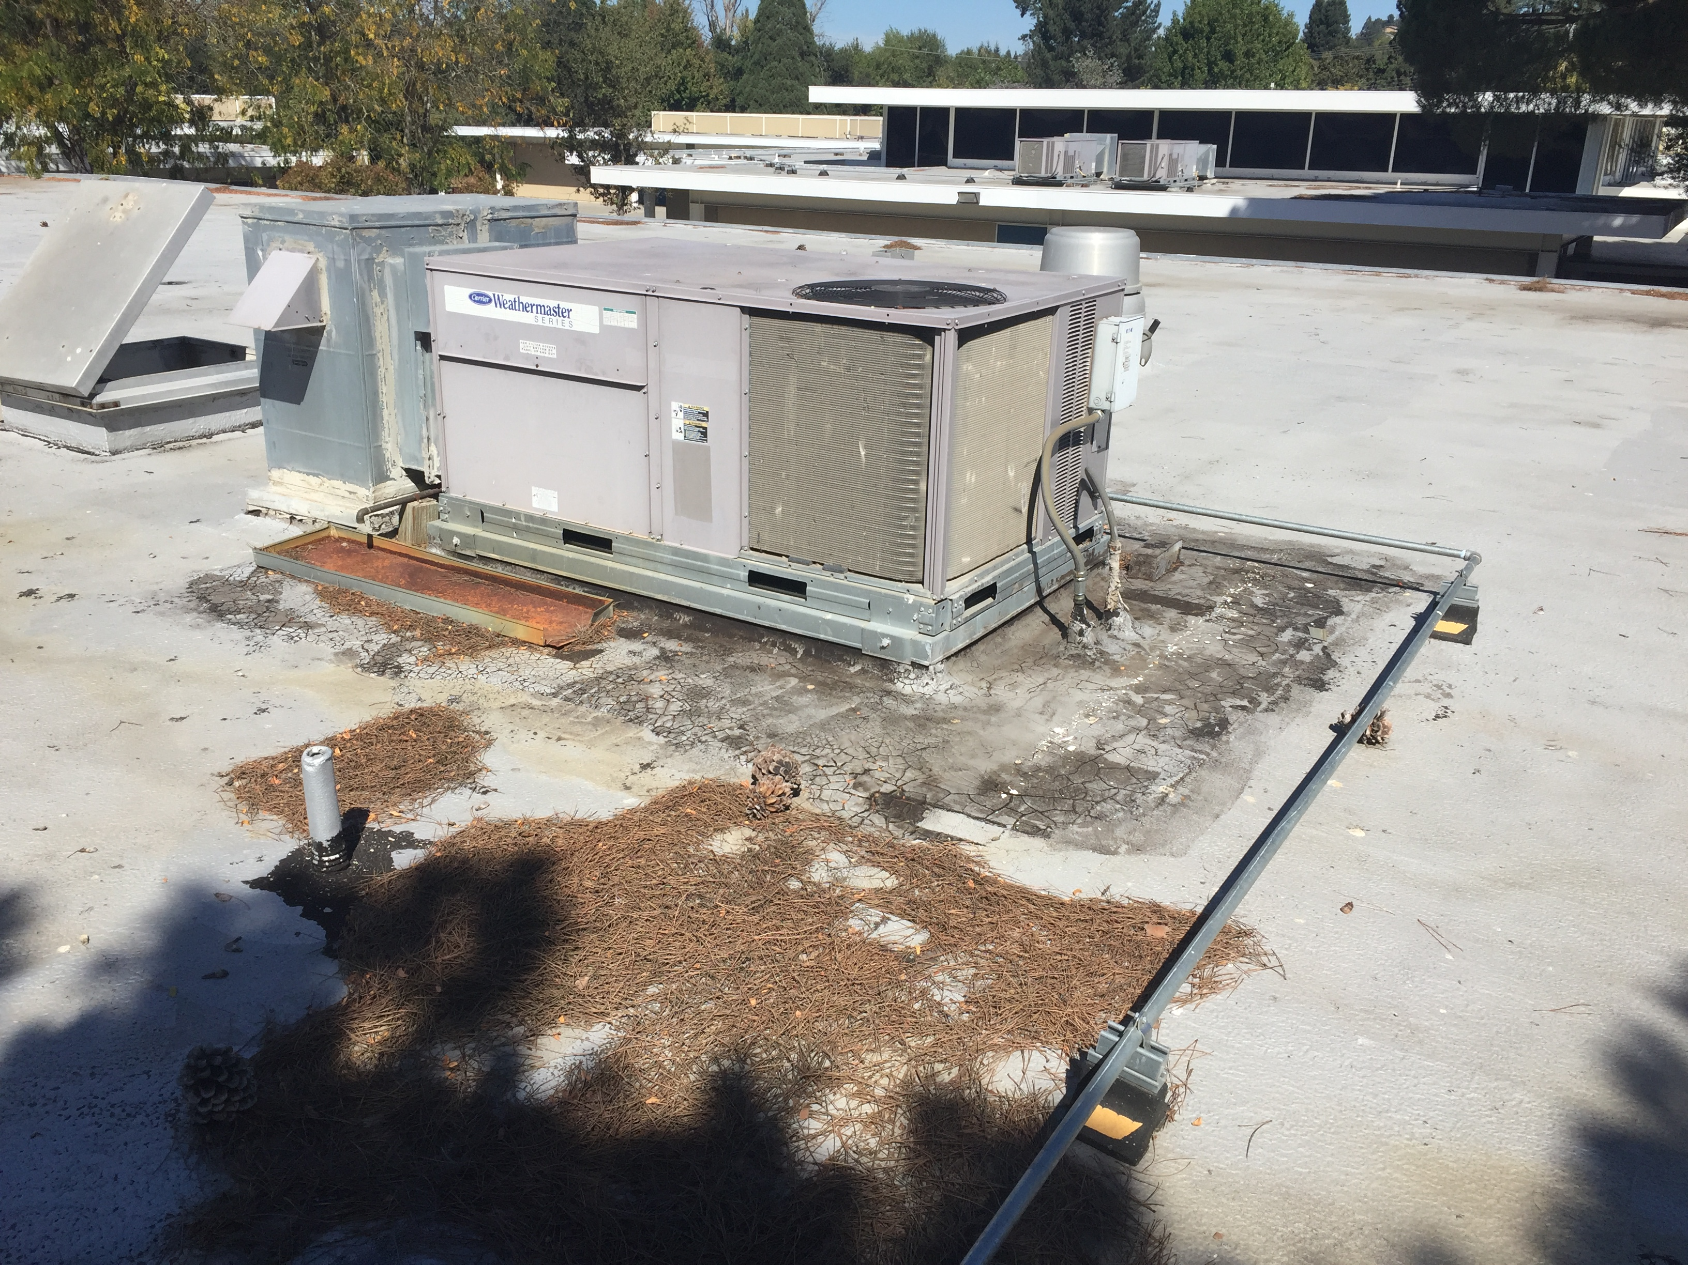
Recent Activity – JMIS Bldg G Roof Replacement
Before Construction

Slide 5
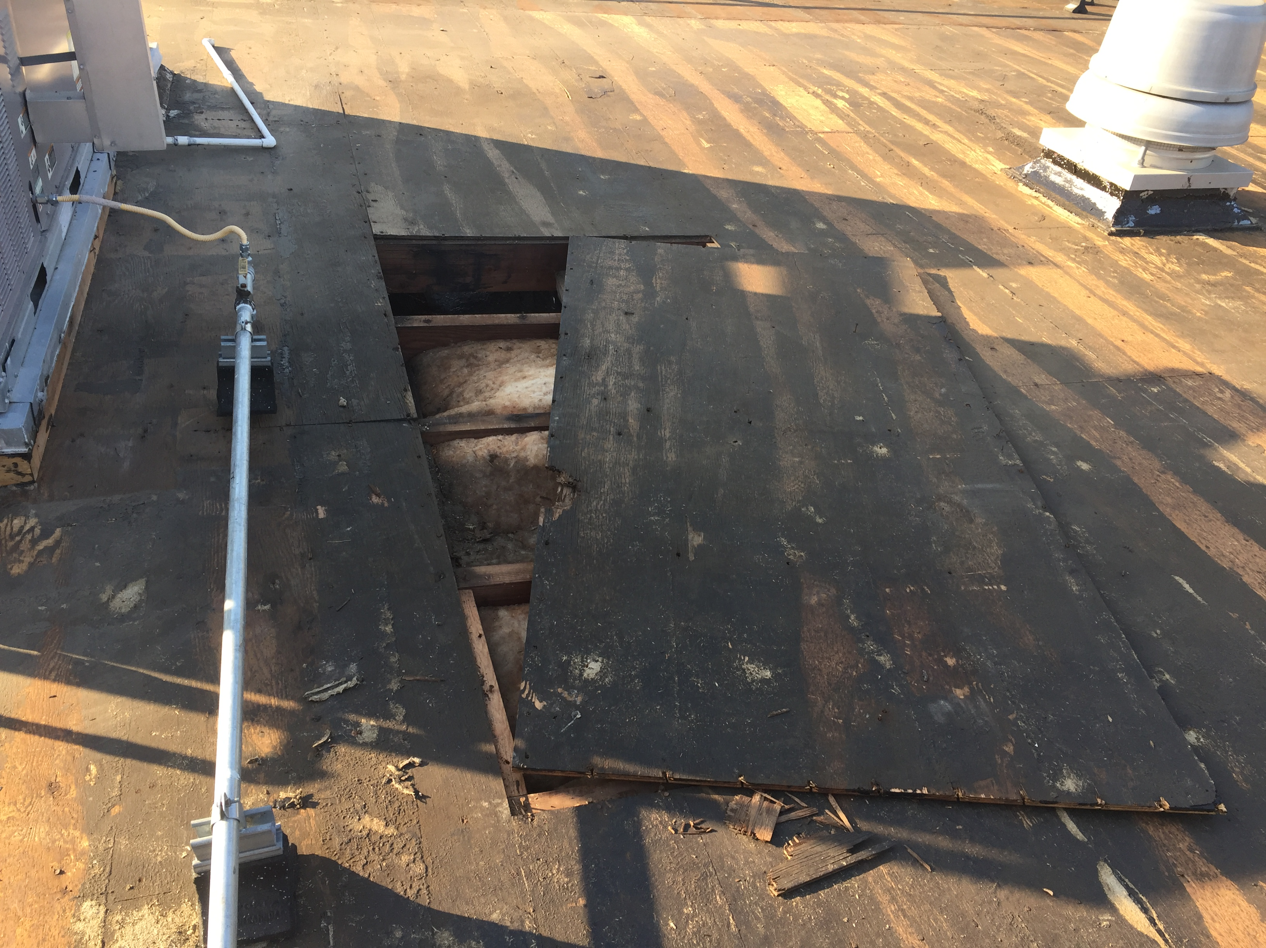
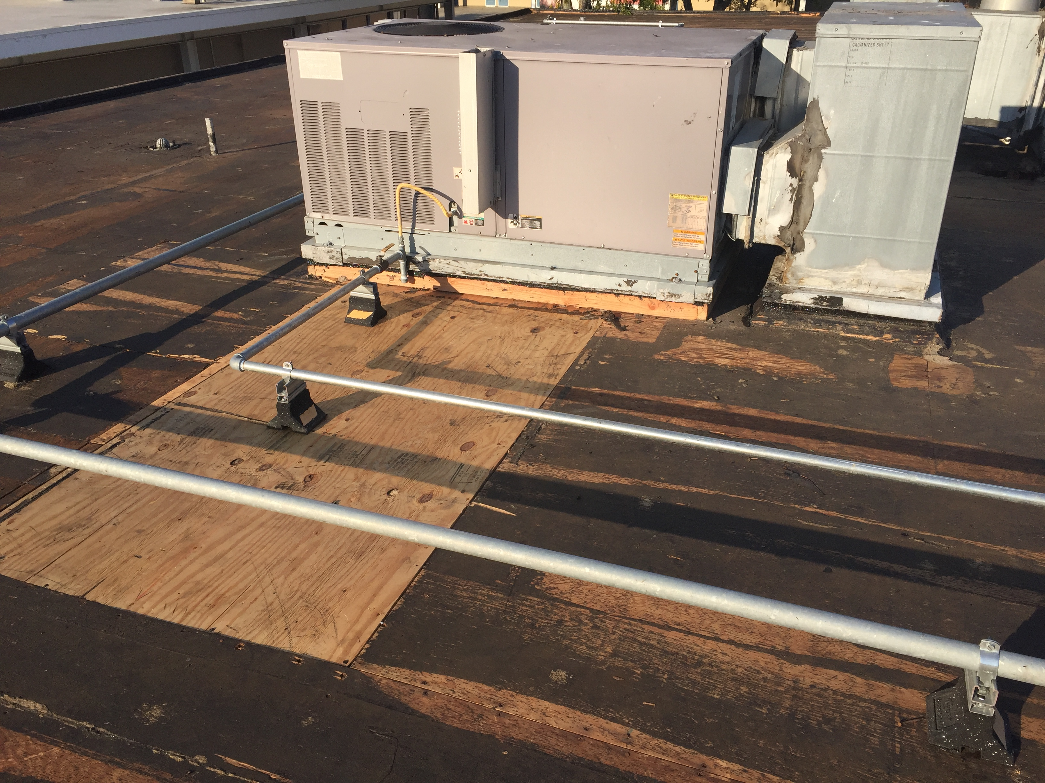
Recent Activity – JMIS Bldg G Roof Replacement
Mid Construction

Slide 6
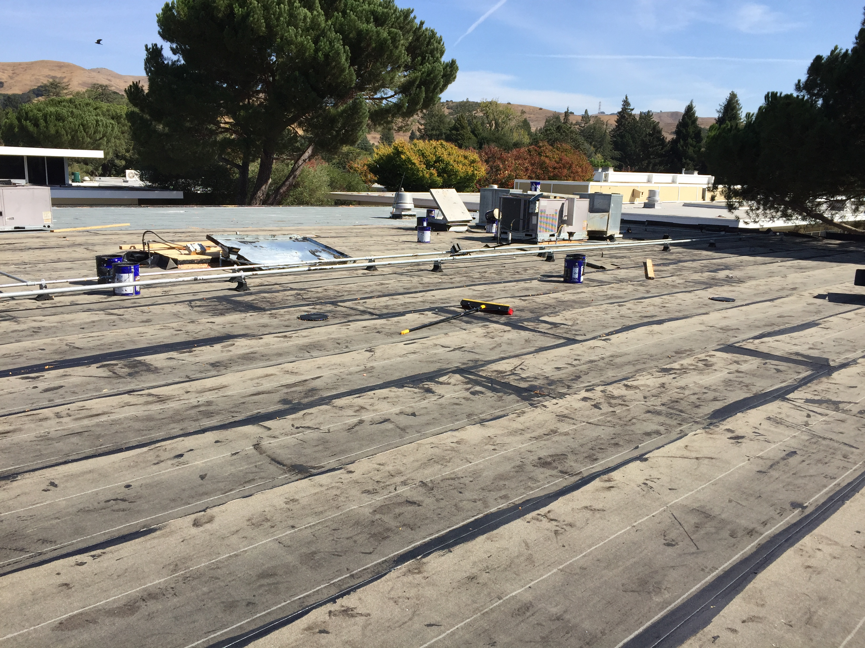
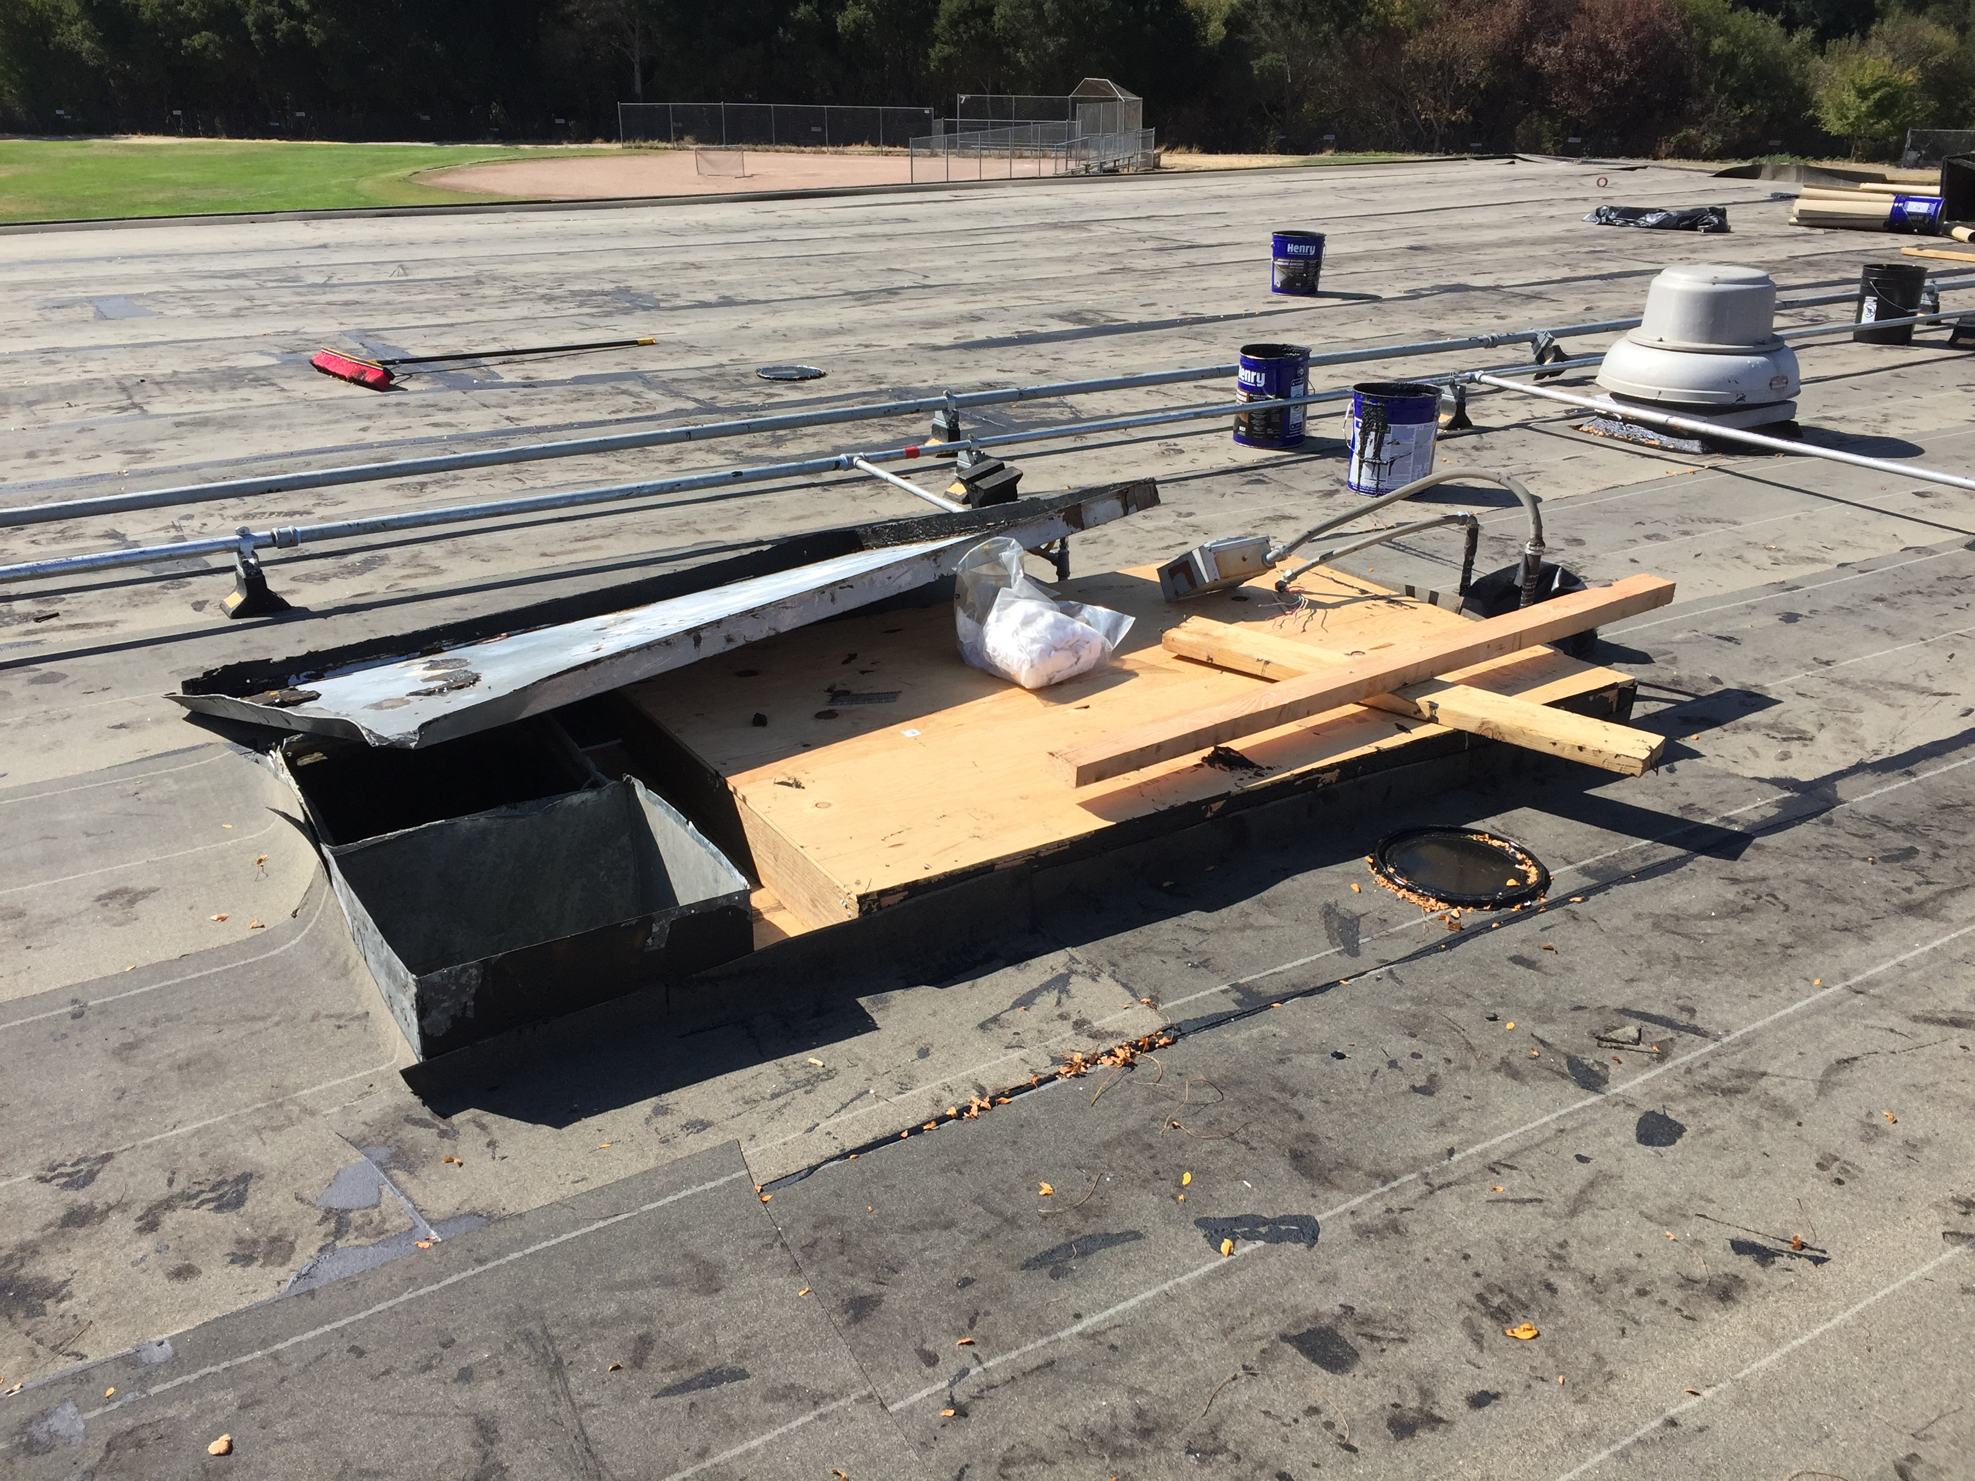
Recent Activity – JMIS Bldg G Roof Replacement
Mid Construction

Slide 7
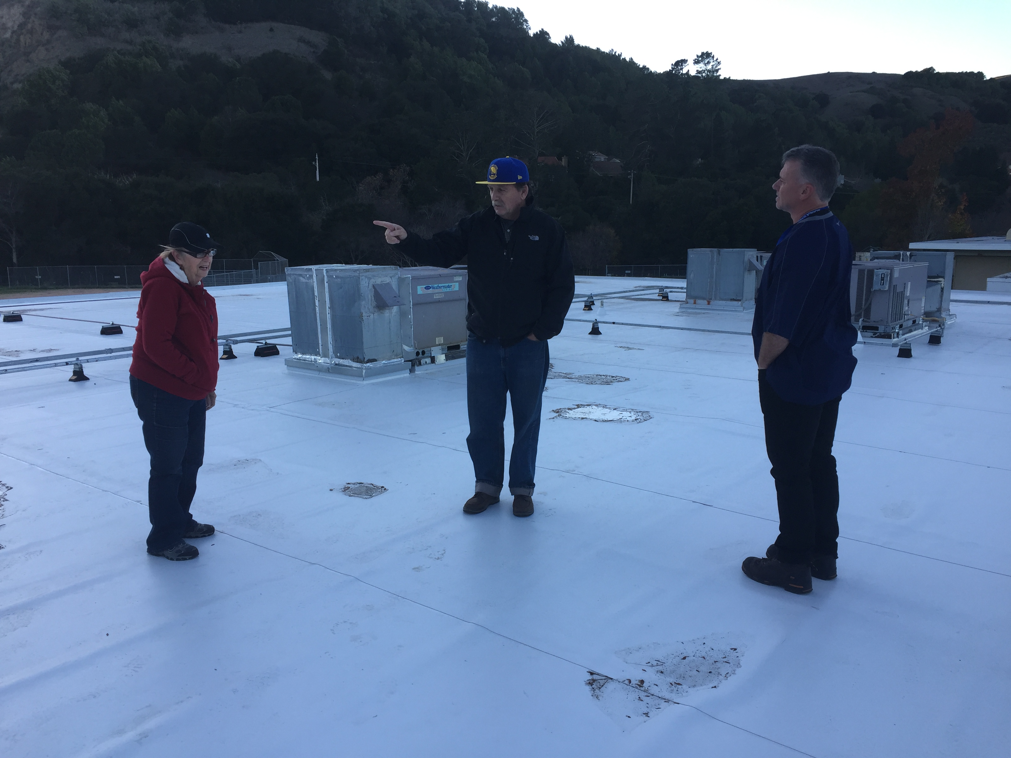
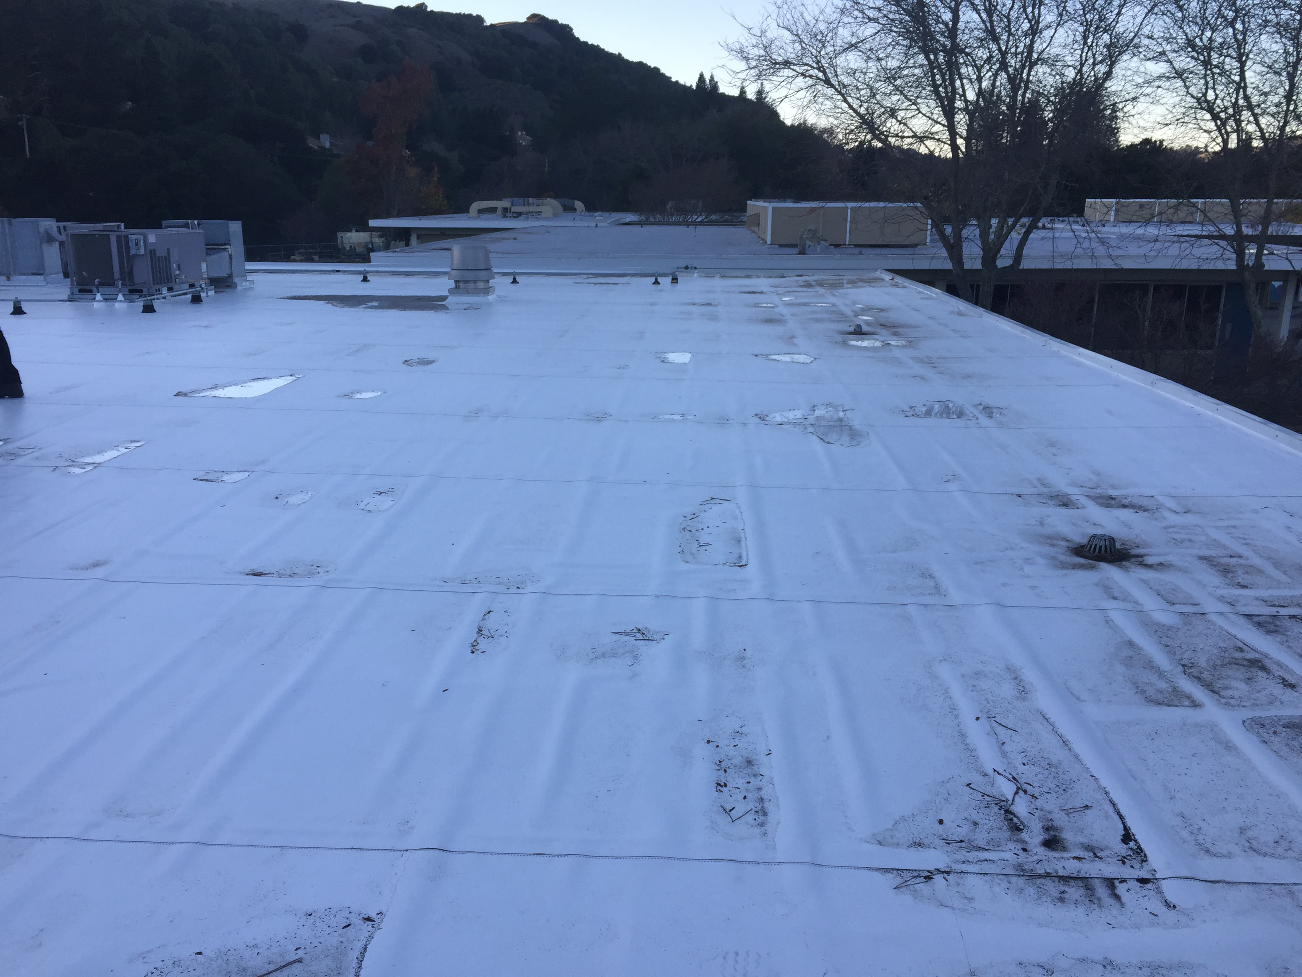
Recent Activity – JMIS Bldg G Roof Replacement
Post Construction

Slide 8
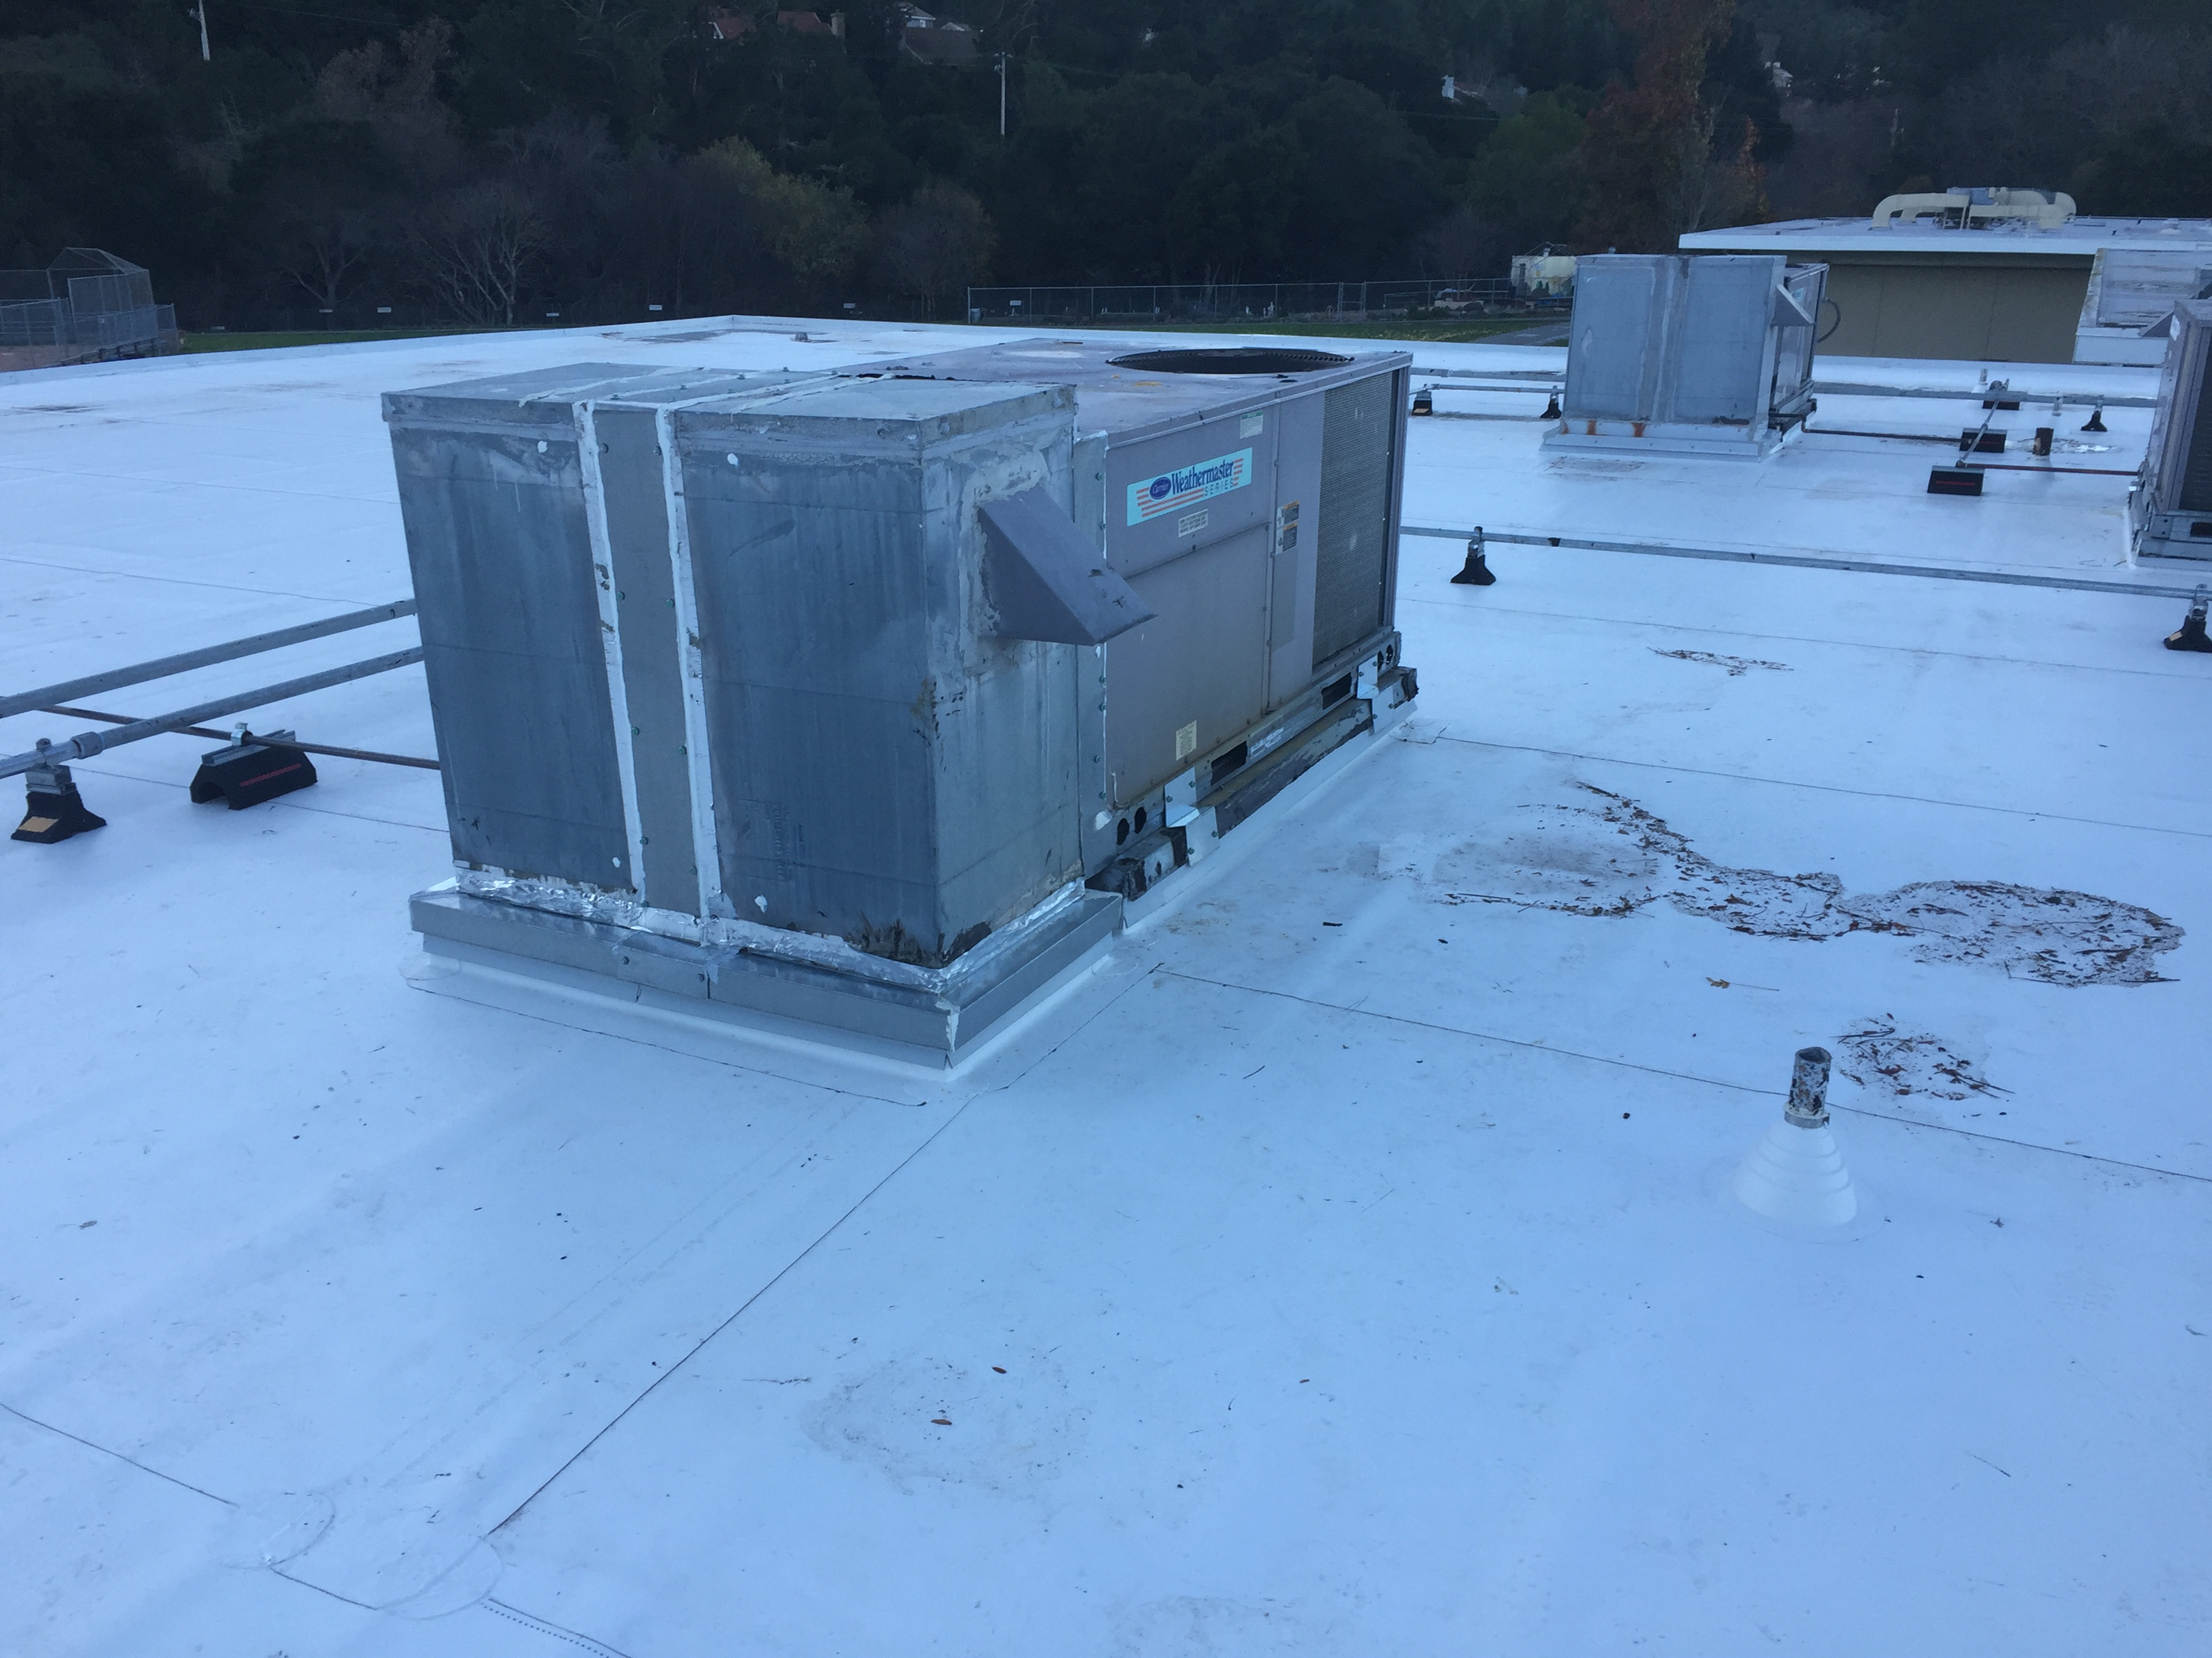
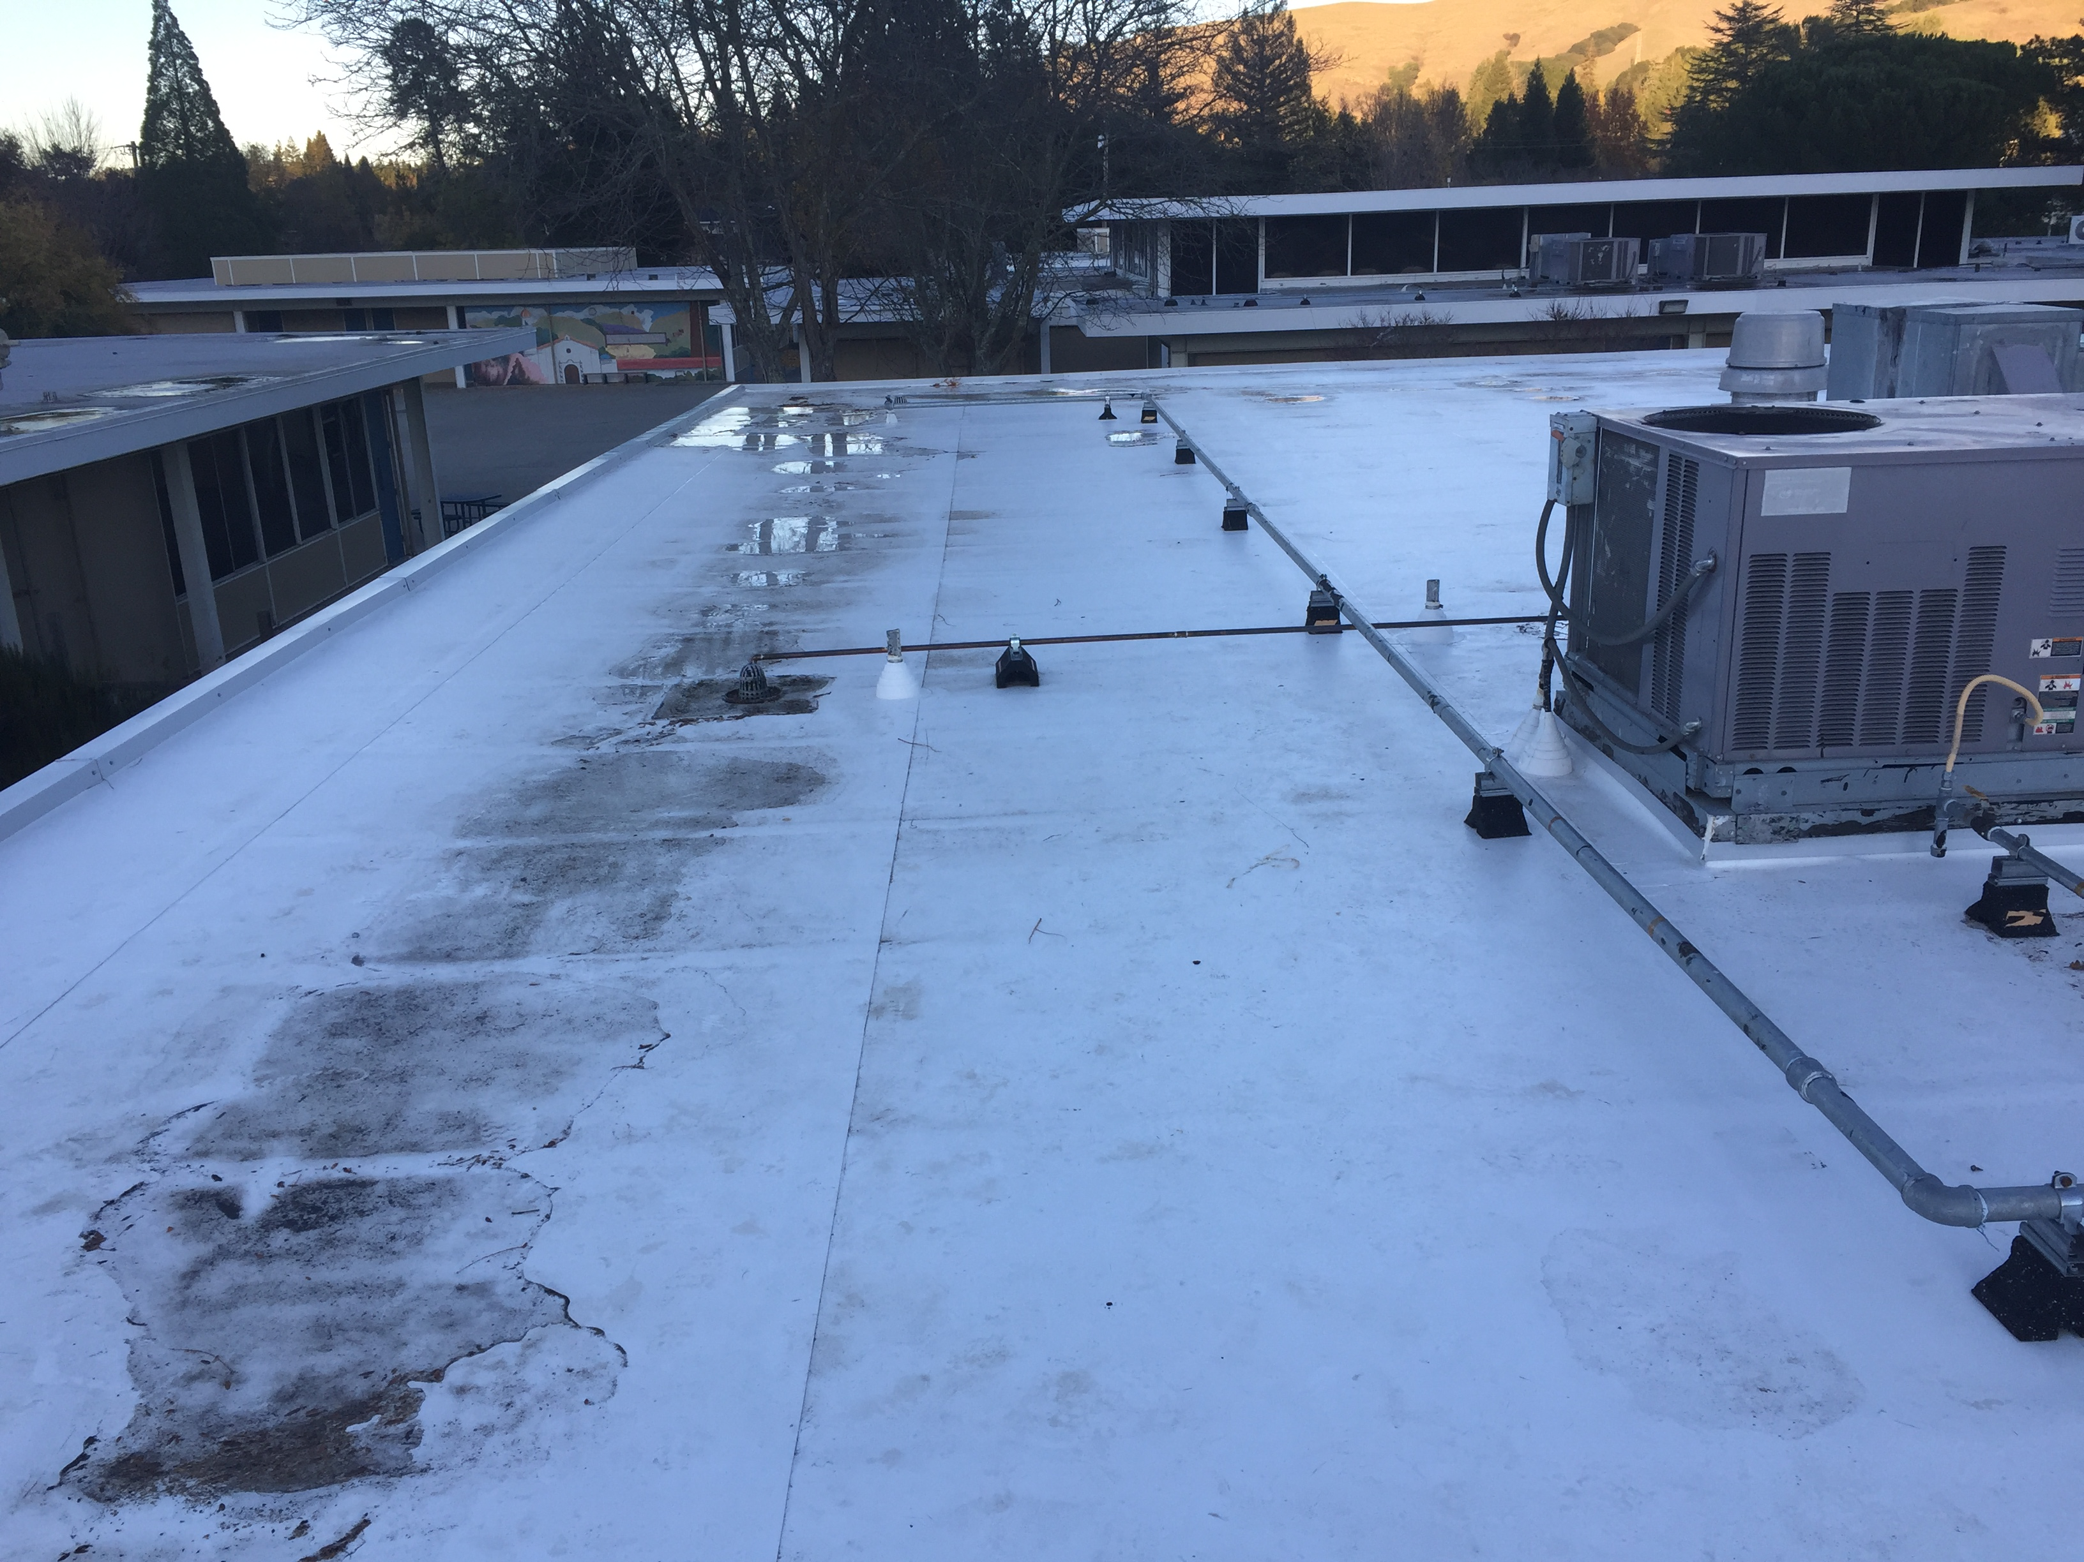
Recent Activity – JMIS Bldg G Roof Replacement
Post Construction

Slide 9
Committees - Update
Steering Committee
Architects, Construction Firm Superintendent, MSD Board members, MSD Superintendent, Principals (elementary and middle schools), Director of Maintenance and Grounds, Chief Business Official
Two November meetings
Construction meetings (every 2-3 weeks) continue
Architects, Construction Firm Superintendent, MSD Superintendent, Director of Maintenance and Grounds, Chief Business Official

Slide 10
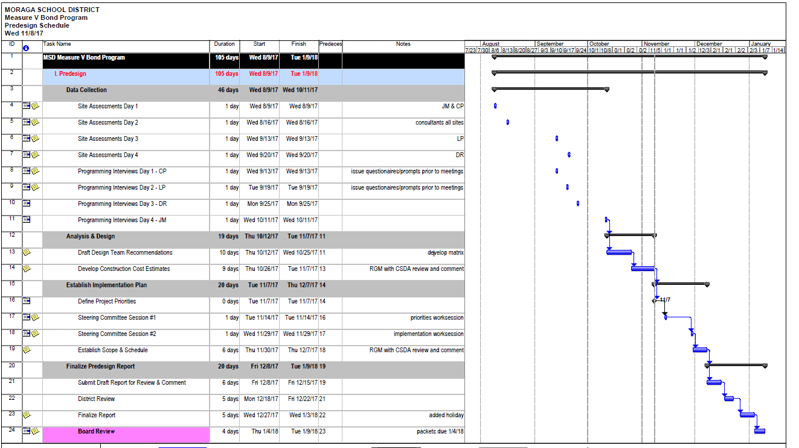
Next Steps
Notes:
Data Collection to Analysis and Desing to Establish a Implementation Plan to Finalizing Pre-design Report – then Board review

Slide 11
Prioritization of 135 Projects Among 4 Schools
CP01 | Access to Campus | replace path at front of school with new concrete accessible ramp | CRC | Code | $200,000
CP09 | Fire Alarm | install new fully addressable FA system with voice evac | CRE | Safety, Code | $90,000
CP21 | Roofing | reroof building #2 (Kinder) | FMP | Maintenance | $183,852
CP28 | Utility Shed | move utility storage to new location and protect utilities | FMP, AR, SG | Maintenance | $50,000
DR10 | Fire Alarm | install new fully addressable FA system with voice evac | CRE | Safety, Code | $90,000
DR14 | MPR tables | replace lunch tables | FMP,DM,SG | Maintenance | $45,000
JM07 | Doors | reframe door to meet ADA clearances | AR | Code | $180,000
JM10 | Fire Alarm | install new fully addressable FA system with voice evac | CRE | Safety, Code | $155,000
JM27 | Roofing | reroof Gym and Music buildings | FMP,DM | Maintenance | $700,000
JM36 | Dryrot | repair fascias | DM | Maintenance | $200,000
LP02 | Common Area | remodel common area to support 21st Century teaching/learning | SG,AR | Program, 21C | $55,000
LP05 | Doors | reframe door to meet ADA clearances | AR | Code | $120,000
LP07 | Fire Alarm | install new fully addressable FA system with voice evac | CRE | Safety, Code | $90,000
LP13 | MPR tables | replace lunch tables | FMP,DM,SG | Maintenance | $45,000
LP29 | Dryrot | repair breezeway roof and fascias | AR, DM | Maintenance | $50,000
DR16 | Painting | repaint exteriors | FMP | Maintenance | $110,000
CP02 | Classrooms | refinish casework, new countertops, new sinks, replace acoustic ceiling, replace flooring (60/30 carpet/lino), new wall display surfaces, paint | FMP, AR, SG | Maintenance, 21C | $630,000
DR02 | Classrooms | refinish casework, new countertops, new sinks, replace acoustic ceiling, replace flooring (60/30 carpet/lino), new wall display surfaces, paint | FMP, AR, SG | Maintenance, 21C | $700,000
DRAFT

Slide 12
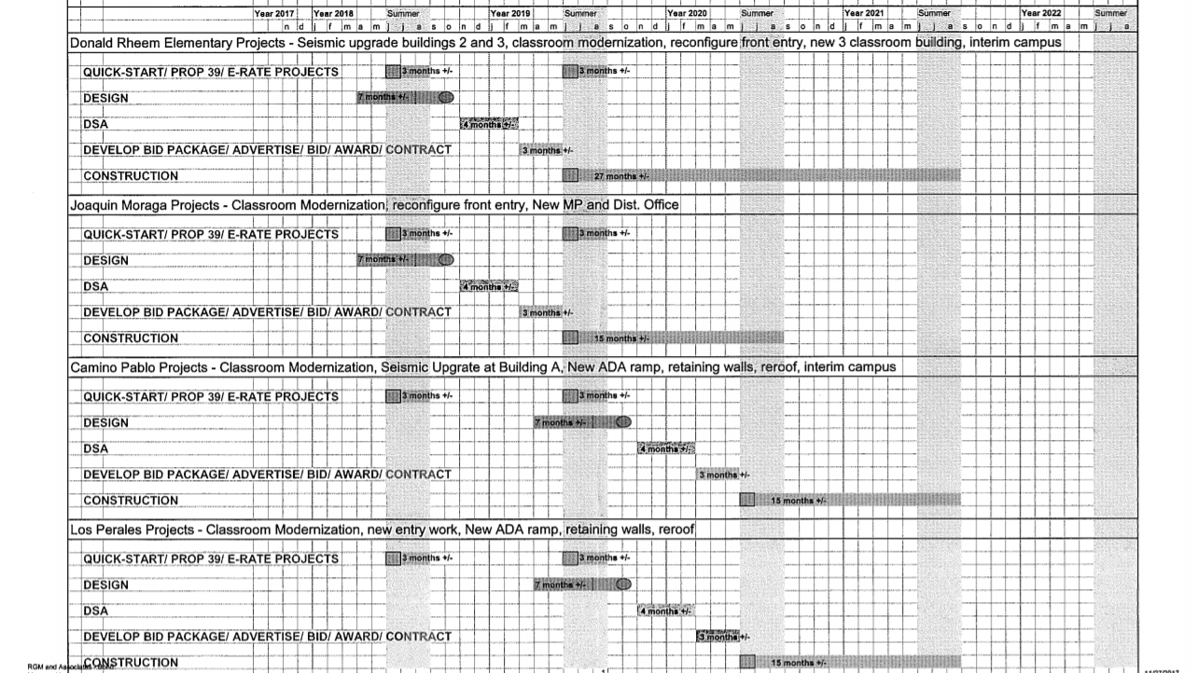
Schedule Development
DRAFT
Notes:
Expert roofer estimated

Slide 13
12/12/17 Expenditure Report
Project | BUDGET | ACTUALS | BALANCE
Available Bond Funds as of 07/01/2017: | $ 11,830,000 | $ 11,830,000 | $ -
Expenditures:
Quickstart-LP Seal and Coat | $ 11,750 | $ 11,750.00 | $ -
Quickstart-CP Wall Project | $ 15,803 | $ 15,803.00 | $ -
Quickstart-JM Re-roofing Building G | $ 192,936 | $ 180,994.96 | $ 11,941.04
Legal | $ 14,000 | $ 6,460.50 | $ 7,539.50
RGM Contract (Construction Management Firm) | $ 188,600 | $ - | $ 188,600.00
CSDA Contract (Architect Contract) | $ 75,000 | $ 37,506.45 | $ 37,493.55
Williams & Associates-Facilities Financial Consultant | $ 27,880 | $ - | $ 27,880.00
Total Expenditures: | $ 525,969 | $ 252,514.91 | $ 273,454.09
Total Available Budget: | $ 11,304,031
Notes:
Expert roofer estimated

Slide 14
Consultant Selection Process
Developed Response for Proposal (RFP)
Content examples: project description, expectations, estimated budget, timelines, scope of service, pre-construction, construction, close-out, proposal requirements, firm history, employee experience and evaluation criteria
RFPs Published
Local newspaper, MSD website, response to request
Interview
Superintendent, Director Maintenance and Facilities, Chief Business Officer, former MSD CBO, Board member, Representative from Construction firm
Evaluation per RFP Criteria
Panels developed interview questions
Evaluations – rating system
Reference Checks
Recommendation to the Governing Board
Notes:
Experience and expertise of firm
Evidence of financial capacity and staffing to properly and efficiently complete the work proposed
Past performance conducting similar projects of size and type
Demonstration of creative and cost-effective design solutions
Ability to meet time schedules and budgets including the fast-track of high priority projects
Proposed method and schedule of fees
Project Plan/Methodology

Slide 15
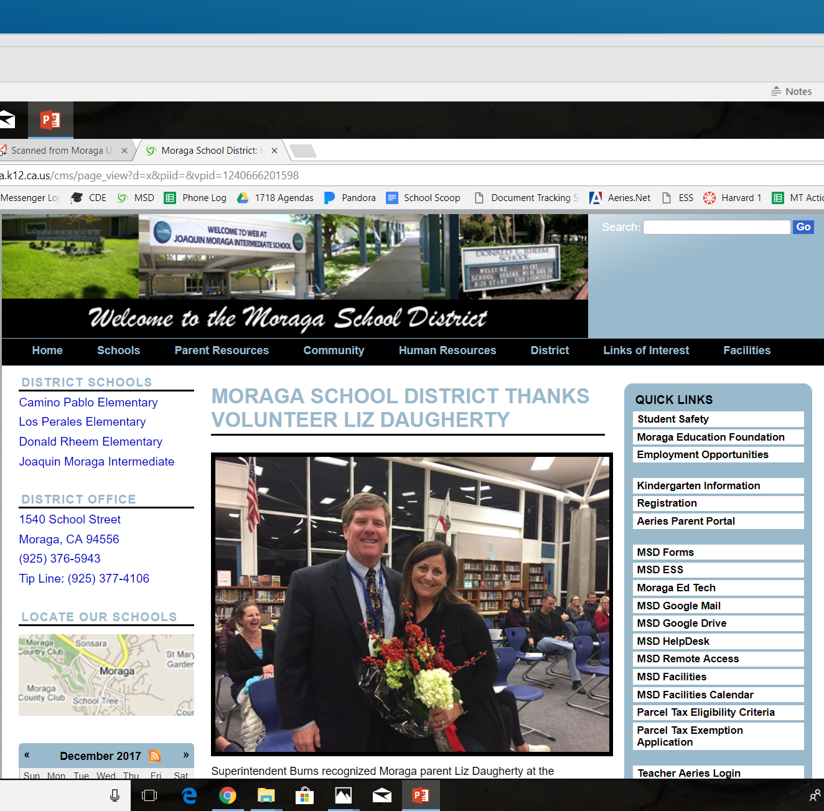
www.moraga.k12.ca.us
HERE
Review
MSD
Web Site
From homepage, select Facilities, then Citizens’ Bond Oversight Committee

